Slide 1
MALCOM Machine Learning for Communication Systems Lecture 6 Generative Adversarial Networks (GANs) Photios Stavrou (The slides are courtesy of Marios Kountouris) Spring 2024

Slide 2

Magic of GANs: Image Enhancement
Which one is Computer generated?
Ledig et al.: Photo-Realistic Single Image Super-Resolution Using a Generative Adversarial Network, CVPR, 2017
Notes:
Ajouter une photo d’un vieux telegraphe, puis un mobile satellitte ancienne generation…can someone find an even older wireless communication system (smoke)

Slide 3
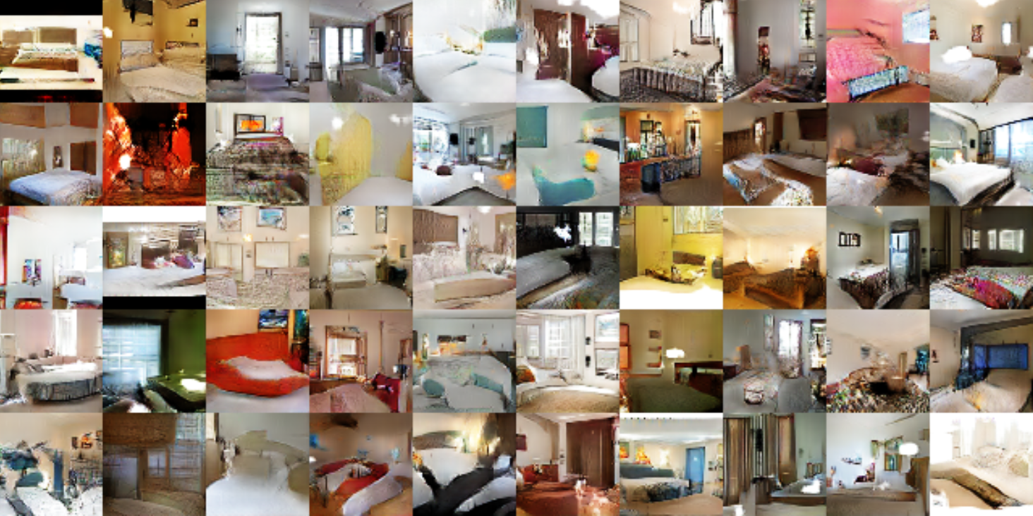
Magic of GANs: DCGANs in LSUN Dataset
Radford et al.: Unsupervised representation learning with DCGANs, arxiv.org, 2015
Notes:
Ajouter une photo d’un vieux telegraphe, puis un mobile satellitte ancienne generation…can someone find an even older wireless communication system (smoke)

Slide 4
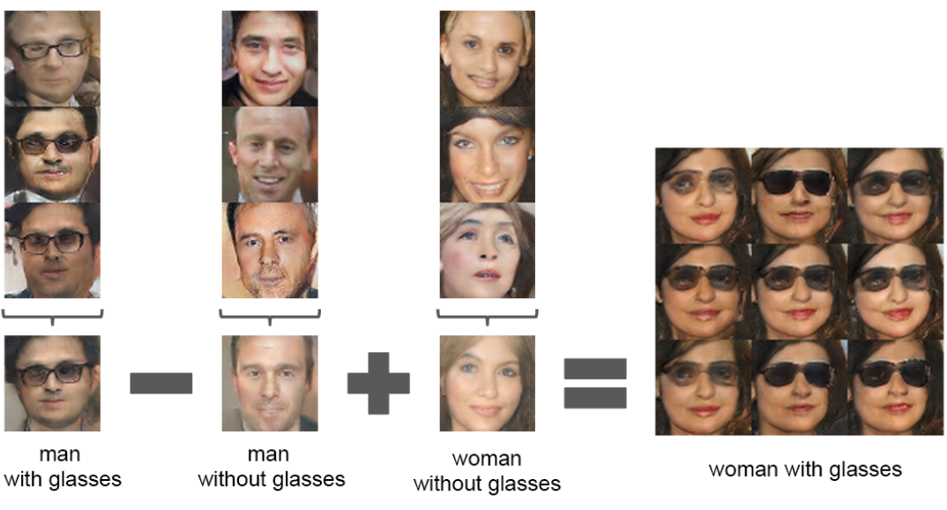
Vector Arithmetic for Visual Concepts
Latent vectors capture interesting patterns!
Radford et al.: Unsupervised representation learning with DCGANs, arxiv.org, 2015
Notes:
Ajouter une photo d’un vieux telegraphe, puis un mobile satellitte ancienne generation…can someone find an even older wireless communication system (smoke)

Slide 5
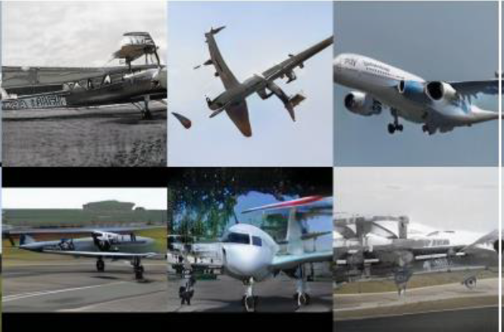
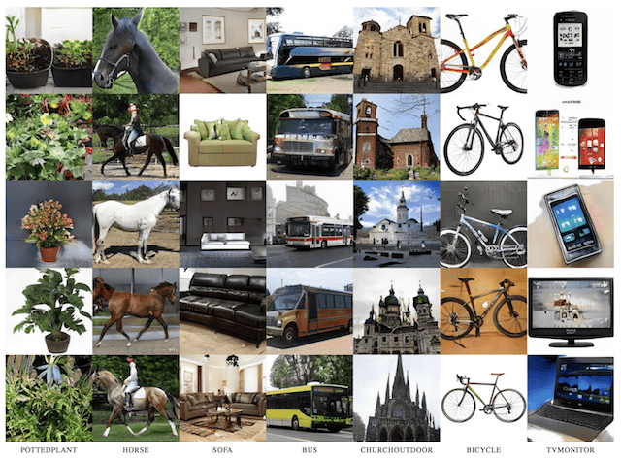
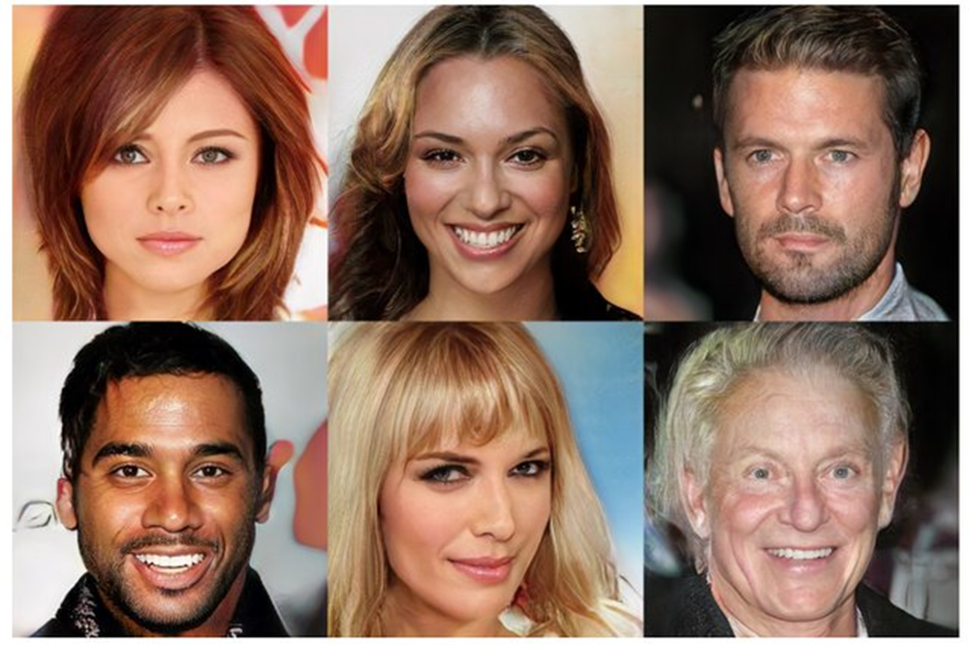
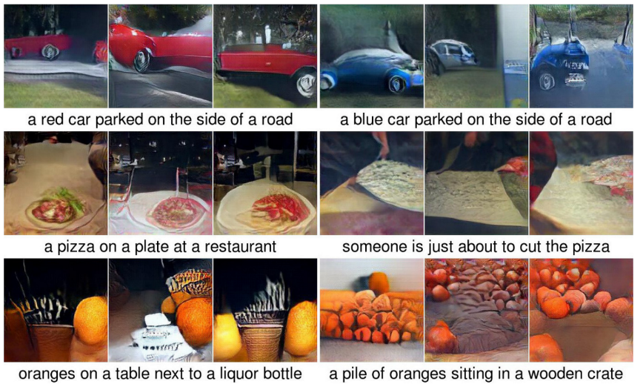
Magic of GANs – Synthetic Photos
Notes:
Ajouter une photo d’un vieux telegraphe, puis un mobile satellitte ancienne generation…can someone find an even older wireless communication system (smoke)

Slide 6
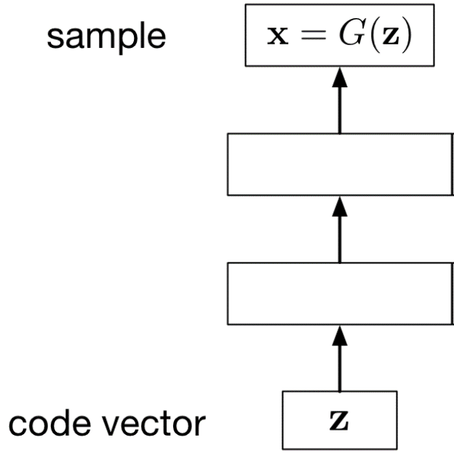
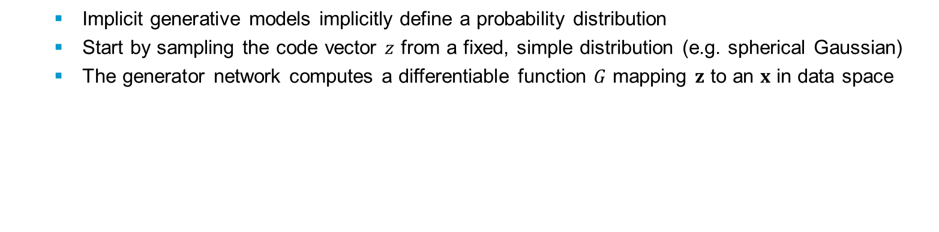
Implicit Generative Models
Implicit generative models implicitly define a probability distribution
Start by sampling the code vector $z$ from a fixed, simple distribution (e.g. spherical Gaussian)
The generator network computes a differentiable function $G$ mapping $z$ to an $x$ in data space
Notes:
Ajouter une photo d’un vieux telegraphe, puis un mobile satellitte ancienne generation…can someone find an even older wireless communication system (smoke)

Slide 7
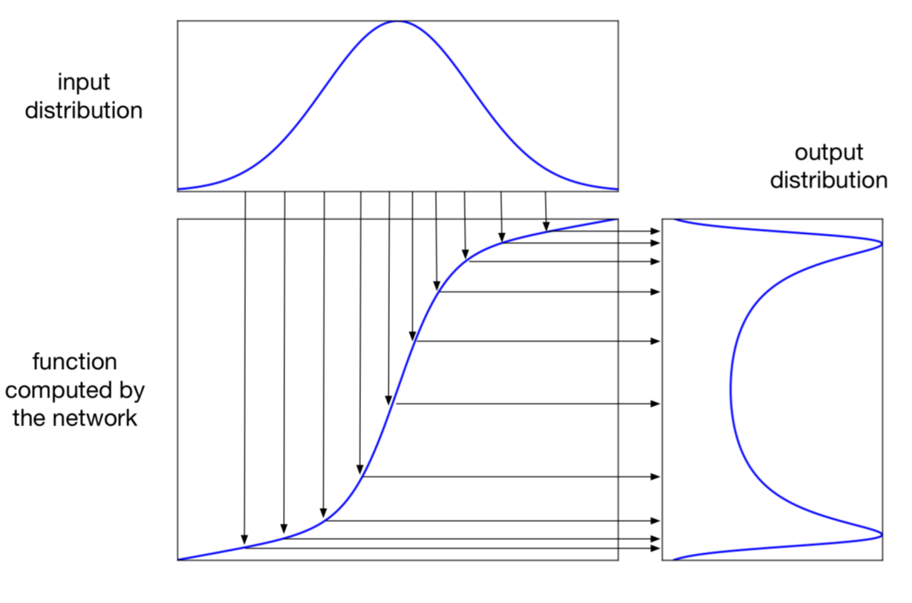
Implicit Generative Models (Cont’d)
A 1-dimensional example:
Notes:
Ajouter une photo d’un vieux telegraphe, puis un mobile satellitte ancienne generation…can someone find an even older wireless communication system (smoke)

Slide 8
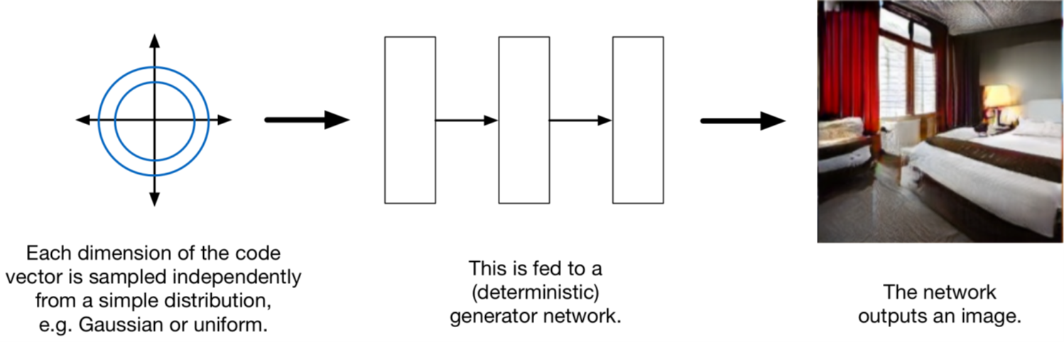
Implicit Generative Models (Cont’d)
This sort of architecture may sound absurd, but amazingly, it works!!
Notes:
Ajouter une photo d’un vieux telegraphe, puis un mobile satellitte ancienne generation…can someone find an even older wireless communication system (smoke)

Slide 9
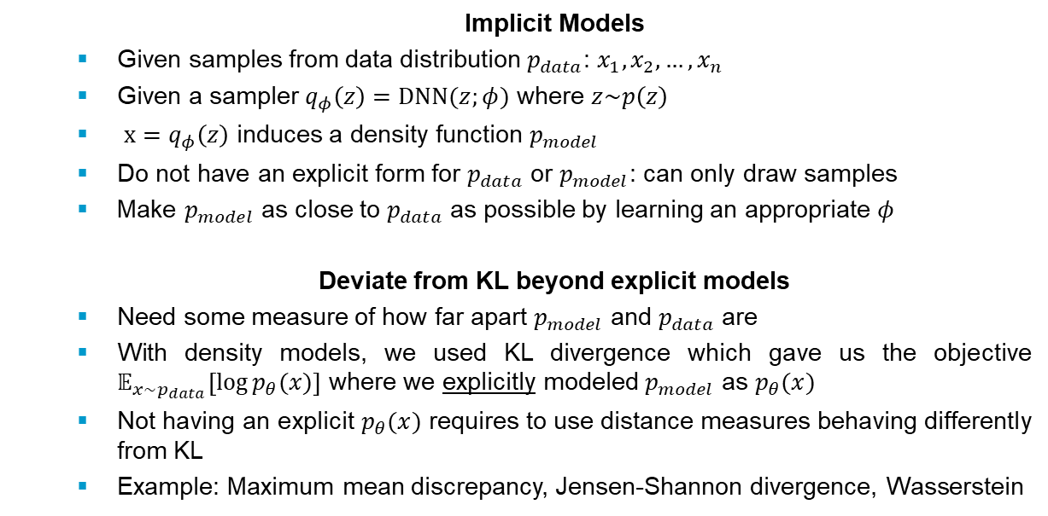
What if we just want to sample?
Idea: don’t explicitly model density – just sample to generate new instances
Problem: Want to sample from complex, high-dimensional training distribution. No direct way to do this!
Solution: Sample from a simple distribution (e.g. random noise).
Learn transformation to data distribution.
Output: Sample from training distribution
Implicit Models
Given samples from data distribution $p_{data}$: $x_{1},x_{2},…,x_{n}$
Given a sampler $q_{φ}\left(z\right)=DNN(z;φ)$ where $z\sim p\left(z\right)$
$x=q_{φ}\left(z\right)$ induces a density function $p_{model}$
Do not have an explicit form for $p_{data}$ or $p_{model}$: can only draw samples
Make $p_{model}$ as close to $p_{data}$ as possible by learning an appropriate $φ$
Deviate from KL beyond explicit models
Need some measure of how far apart $p_{model}$ and $p_{data}$ are
With density models, we used KL divergence which gave us the objective $𝔼_{x\sim p_{data}}\left[\log{p_{θ}(x)}\right]$ where we explicitly modeled $p_{model}$ as $p_{θ}(x)$
Not having an explicit $p_{θ}(x)$ requires to use distance measures behaving differently from KL
Example: Maximum mean discrepancy, Jensen-Shannon divergence, Wasserstein
Input: Random noise
Notes:
Ajouter une photo d’un vieux telegraphe, puis un mobile satellitte ancienne generation…can someone find an even older wireless communication system (smoke)

Slide 10
Generative Adversarial Networks – Basic Idea
Implicit generative models advantage:
if you have some criterion for evaluating the quality of samples
… then you can compute its gradient with respect to the network parameters,
and update the network's parameters to make the sample a little better
Basic idea
Generator
tries to produce realistic-looking samples
creates fake data from random input
Discriminator
tries to figure out whether a sample came from the training set or the generator network
distinguish real data from fake data
Notes:
Ajouter une photo d’un vieux telegraphe, puis un mobile satellitte ancienne generation…can someone find an even older wireless communication system (smoke)

Slide 11
GANs
Generator
Faking Data
To create good fake data, the generator must understand what real data looks like
Attempts to generate samples that are likely under the true data distribution
Implicitly learns to model the true distribution
Latent Code
Since the sample is determined by the random noise input, the probability distribution is conditioned on this input
The random noise is interpreted by the model as a latent code, i.e., a point on the manifold
Problem Setup
Generator
Trained to get better and better at fooling the discriminator (making fake data look real)
Discriminator
Trained to get better and better at distinguishing real data from fake data
Notes:
Ajouter une photo d’un vieux telegraphe, puis un mobile satellitte ancienne generation…can someone find an even older wireless communication system (smoke)

Slide 12
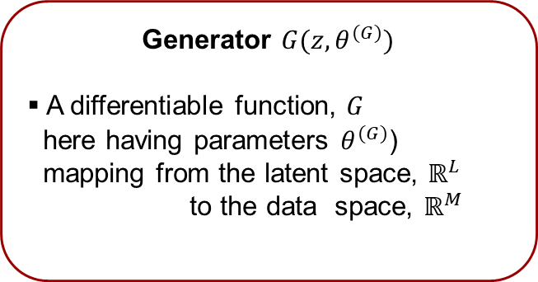
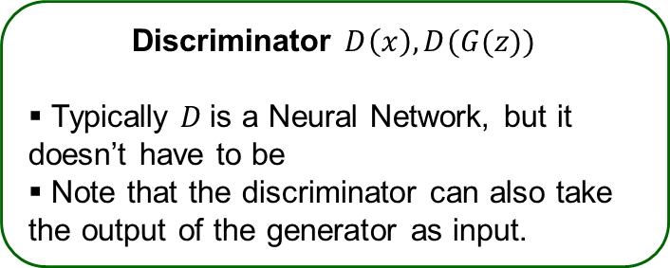
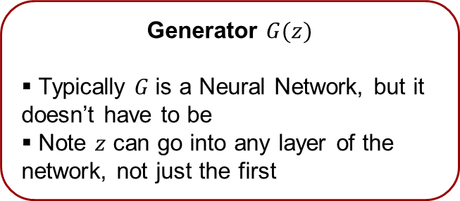
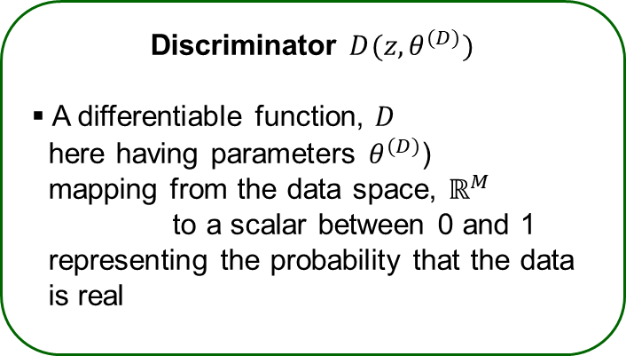
GANs: High Level Explanation
Problem Formulation
Generator $G(z,θ^{(G)})$
A differentiable function, $G$
here having parameters $θ^{(G)}$)
mapping from the latent space, $ℝ^{L}$
to the data space, $ℝ^{M}$
Discriminator $D(z,θ^{(D)})$
A differentiable function, $D$
here having parameters $θ^{(D)}$)
mapping from the data space, $ℝ^{M}$
to a scalar between 0 and 1
representing the probability that the data
is real
Simplifying notation
Generator $G(z)$
Typically $G$is a Neural Network, but it doesn’t have to be
Note 𝑧 can go into any layer of the network, not just the first
Discriminator $D\left(x\right), D(G(z))$
Typically $D$is a Neural Network, but it doesn’t have to be
Note that the discriminator can also take the output of the generator as input.
Notes:
Ajouter une photo d’un vieux telegraphe, puis un mobile satellitte ancienne generation…can someone find an even older wireless communication system (smoke)

Slide 13
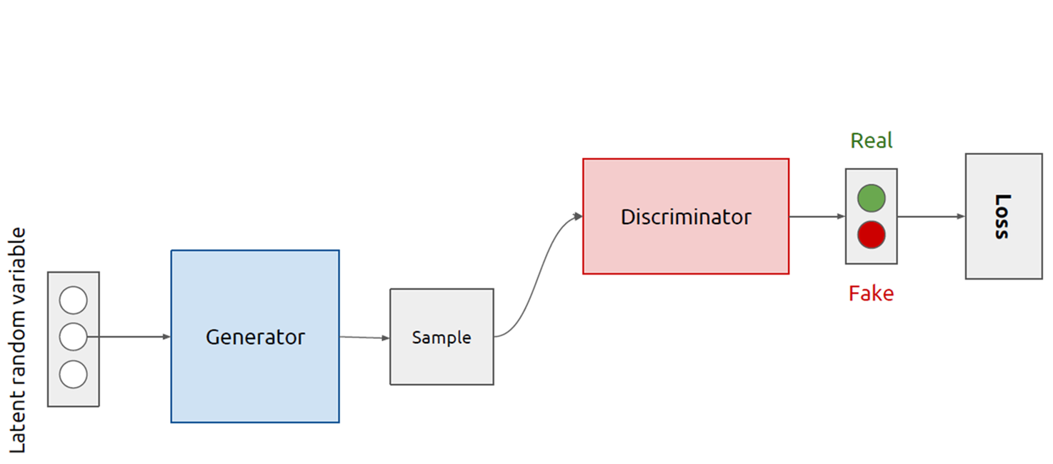
GANs – Two Players (sub-models)
Source: Kevin McGuiness
Notes:
Ajouter une photo d’un vieux telegraphe, puis un mobile satellitte ancienne generation…can someone find an even older wireless communication system (smoke)

Slide 14
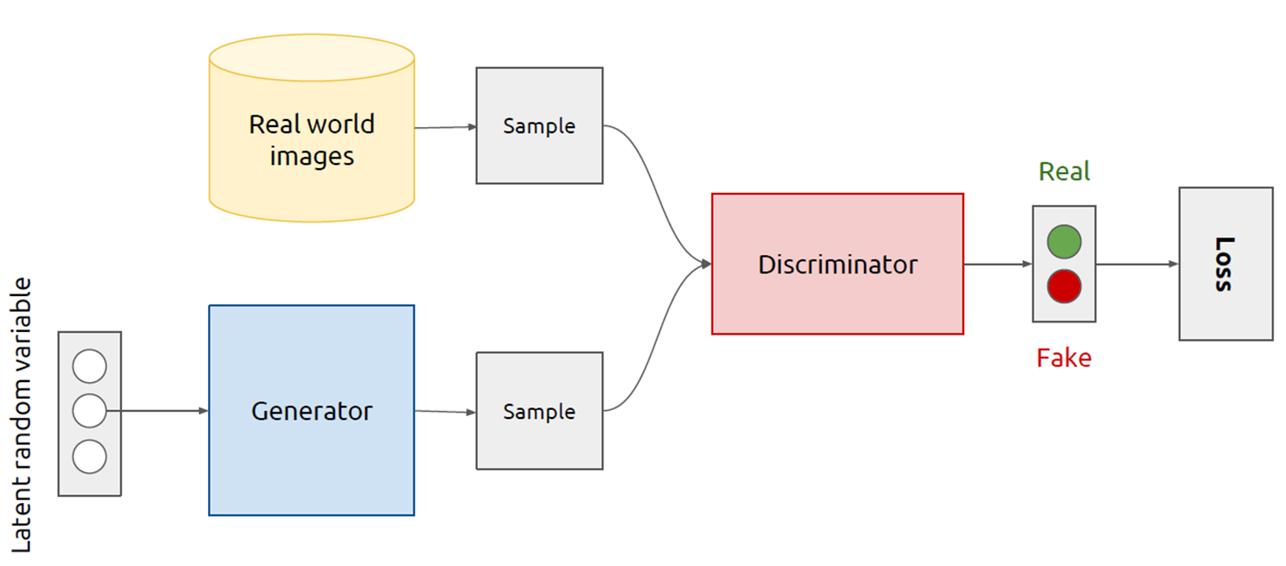
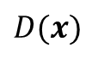
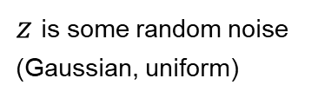
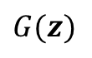
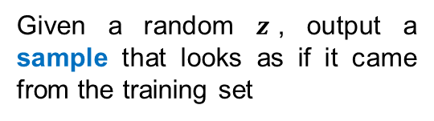
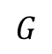
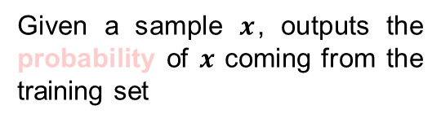
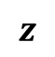
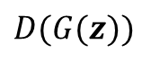
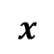
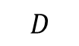
GANs Architecture
$$x$$
Given a sample $x$, outputs the probability of $x$ coming from the training set
$$D(x)$$
$$D$$
$$G$$
$$z$$
$$G(z)$$
$$D(G(z))$$
Given a random $z$, output a sample that looks as if it came from the training set
$z$ is some random noise (Gaussian, uniform)
Source: Kevin McGuiness
Notes:
Ajouter une photo d’un vieux telegraphe, puis un mobile satellitte ancienne generation…can someone find an even older wireless communication system (smoke)

Slide 15
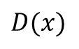
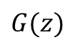
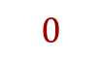
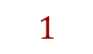
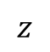
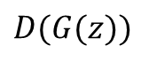
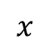
Training GANs: An Alternating Procedure
Alternate between training the discriminator and generator
$$x$$
differentiable module (deep net)
$$D(x)$$
$$1$$
$$D$$
$$G$$
$$z$$
$$G(z)$$
$$0$$
$$D(G(z))$$
differentiable module (deep net)
Source: Kevin McGuiness
Notes:
Ajouter une photo d’un vieux telegraphe, puis un mobile satellitte ancienne generation…can someone find an even older wireless communication system (smoke)

Slide 16
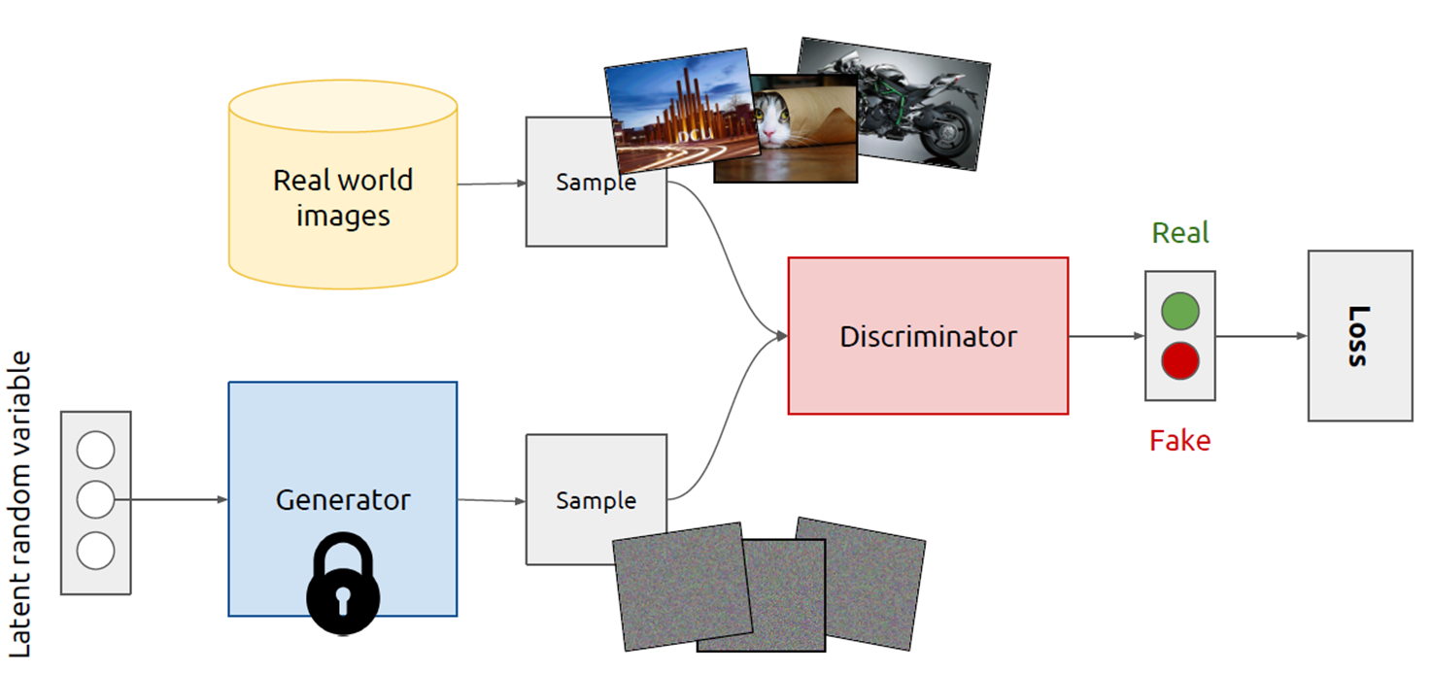
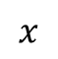
Training Discriminator
1. Fix generator weights, draw samples from both real world and generated images
2. Train discriminator to distinguish between real world and generated images
$$x$$
$$D(x)$$
$$D$$
$$G$$
$$z$$
$$G(z)$$
$$D(G(z))$$
Backprop error to update discriminator weights
Source: Kevin McGuiness
Notes:
Ajouter une photo d’un vieux telegraphe, puis un mobile satellitte ancienne generation…can someone find an even older wireless communication system (smoke)

Slide 17
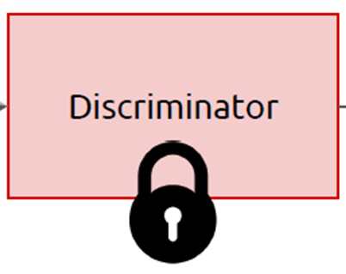
Training Generator
1. Fix discriminator weights
2. Sample from generator
3. Backprop error through discriminator to update generator weights
$$x$$
$$D(x)$$
$$D$$
$$G$$
$$z$$
$$G(z)$$
$$D(G(z))$$
Backprop error to update generator weights
Source: Kevin McGuiness
Notes:
Ajouter une photo d’un vieux telegraphe, puis un mobile satellitte ancienne generation…can someone find an even older wireless communication system (smoke)

Slide 18
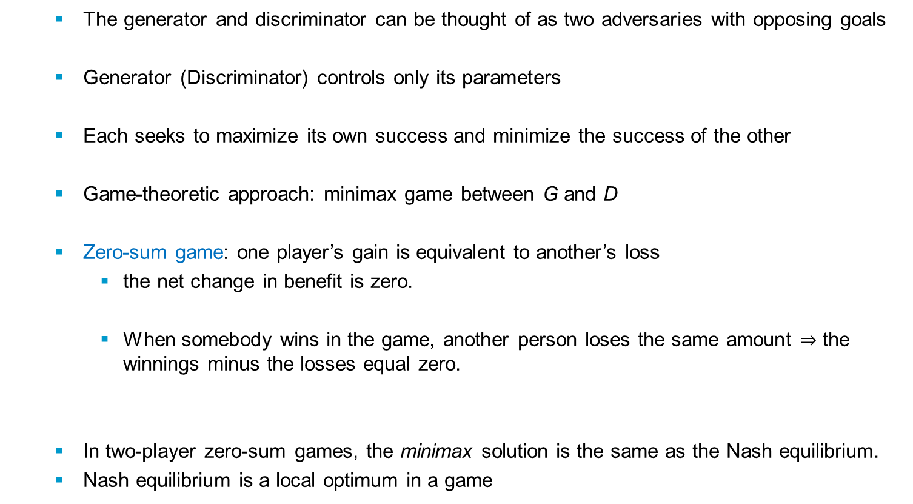
GANs – Game Theoretic Perspective
The generator and discriminator can be thought of as two adversaries with opposing goals
Generator (Discriminator) controls only its parameters
Each seeks to maximize its own success and minimize the success of the other
Game-theoretic approach: minimax game between G and D
Zero-sum game: one player’s gain is equivalent to another’s loss
the net change in benefit is zero.
When somebody wins in the game, another person loses the same amount $⇒$ the winnings minus the losses equal zero.
In two-player zero-sum games, the minimax solution is the same as the Nash equilibrium.
Nash equilibrium is a local optimum in a game
Notes:
Ajouter une photo d’un vieux telegraphe, puis un mobile satellitte ancienne generation…can someone find an even older wireless communication system (smoke)

Slide 19
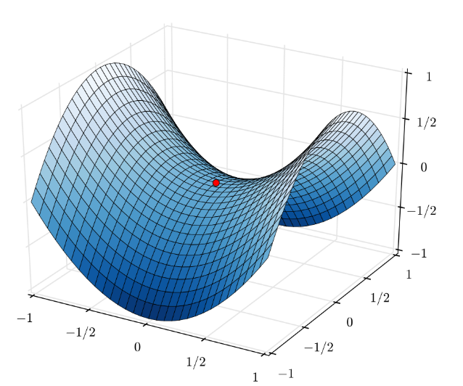
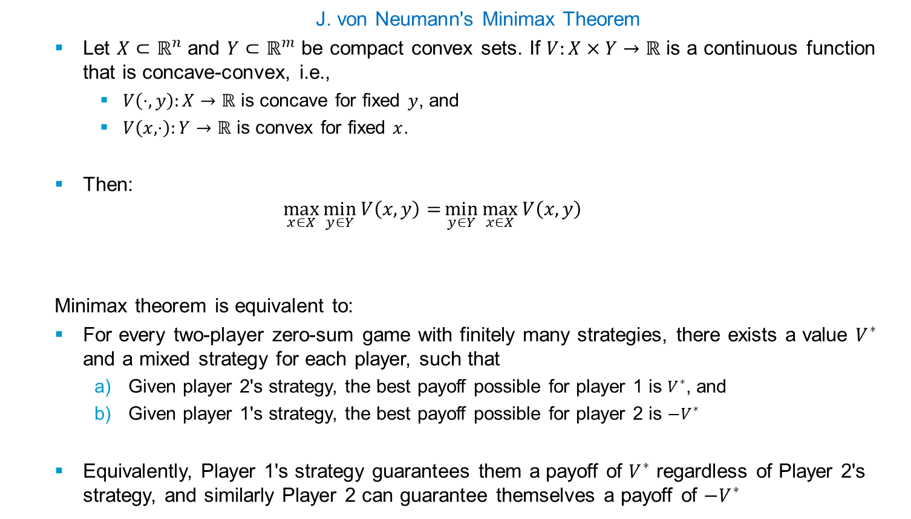
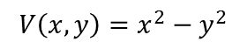
Zero-sum Game and Minimax Theorem
J. von Neumann's Minimax Theorem
Let $X⊂ℝ^{n}$ and $Y⊂ℝ^{m}$ be compact convex sets. If $V:X×Y→ℝ$ is a continuous function that is concave-convex, i.e.,
$V\left(⋅,y\right):X→ℝ$ is concave for fixed $y$, and
$V\left(x, ⋅\right):Y→ℝ$ is convex for fixed $x$.
Then:
$$\max_{x∈X}{\min_{y∈Y}{V\left(x,y\right)=}}\min_{y∈Y}{\max_{x∈X}{V\left(x,y\right)}}$$
Minimax theorem is equivalent to:
For every two-player zero-sum game with finitely many strategies, there exists a value $V^{∗}$ and a mixed strategy for each player, such that
Given player 2's strategy, the best payoff possible for player 1 is $V^{∗}$, and
Given player 1's strategy, the best payoff possible for player 2 is ${−V}^{∗}$
Equivalently, Player 1's strategy guarantees them a payoff of $V^{∗}$ regardless of Player 2's strategy, and similarly Player 2 can guarantee themselves a payoff of ${−V}^{∗}$
$$V\left(x,y\right)=x^{2}−y^{2}$$
Source: https://www.theoremoftheday.org/OR/VonNeumann/TotDVonNeumann.pdf
Notes:
Ajouter une photo d’un vieux telegraphe, puis un mobile satellitte ancienne generation…can someone find an even older wireless communication system (smoke)

Slide 20
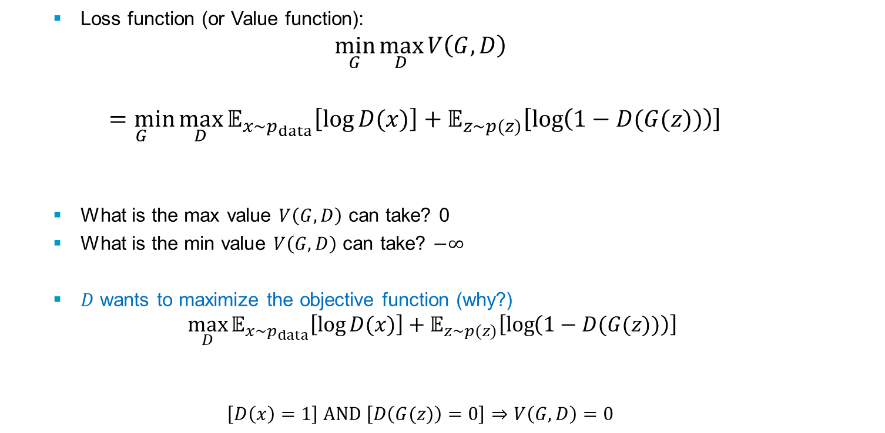
The Minimax Game in GANs
Loss function (or Value function):
$$\min_{G}{\max_{D}{V\left(G,D\right)}}$$
$$\underset{G}{=min}{\max_{D}{𝔼_{x\sim p_{data}}\left[\log{D(x)}\right]+𝔼_{z\sim p(z)}\left[\log\left(1−D(G(z))\right)\right]}}$$
What is the max value $V\left(G,D\right)$ can take? 0
What is the min value $V\left(G,D\right)$ can take? $−∞$
$D$ wants to maximize the objective function (why?)
$${\max_{D}{𝔼_{x\sim p_{data}}\left[\log{D(x)}\right]+𝔼_{z\sim p(z)}\left[\log\left(1−D(G(z))\right)\right]}}$$
$$\left[D\left(x\right)=1\right] AND \left[D\left(G(z)\right)=0\right]⇒V\left(G,D\right)=0$$
training set
generated sample
Notes:
Ajouter une photo d’un vieux telegraphe, puis un mobile satellitte ancienne generation…can someone find an even older wireless communication system (smoke)

Slide 21
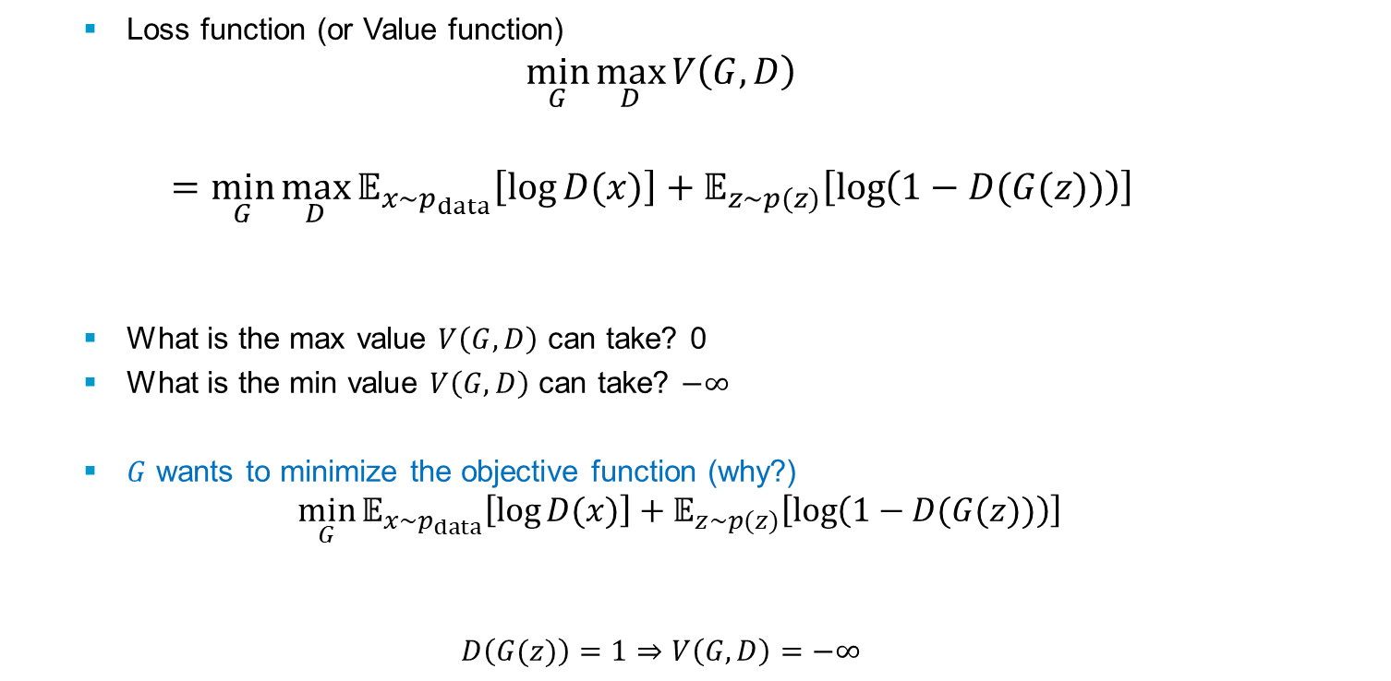
Minimax Game in GANs (cont’d)
Loss function (or Value function)
$$\min_{G}{\max_{D}{V\left(G,D\right)}}$$
$$\underset{ G}{=min}{\max_{D}{𝔼_{x\sim p_{data}}\left[\log{D(x)}\right]+𝔼_{z\sim p(z)}\left[\log\left(1−D(G(z))\right)\right]}}$$
What is the max value $V\left(G,D\right)$ can take? 0
What is the min value $V\left(G,D\right)$ can take? $−∞$
$G$ wants to minimize the objective function (why?)
$${\min_{G}{𝔼_{x\sim p_{data}}\left[\log{D(x)}\right]+𝔼_{z\sim p(z)}\left[\log\left(1−D(G(z))\right)\right]}}$$
$$D\left(G(z)\right)=1⇒V\left(G,D\right)=−∞$$
generated sample
Notes:
Ajouter une photo d’un vieux telegraphe, puis un mobile satellitte ancienne generation…can someone find an even older wireless communication system (smoke)

Slide 22
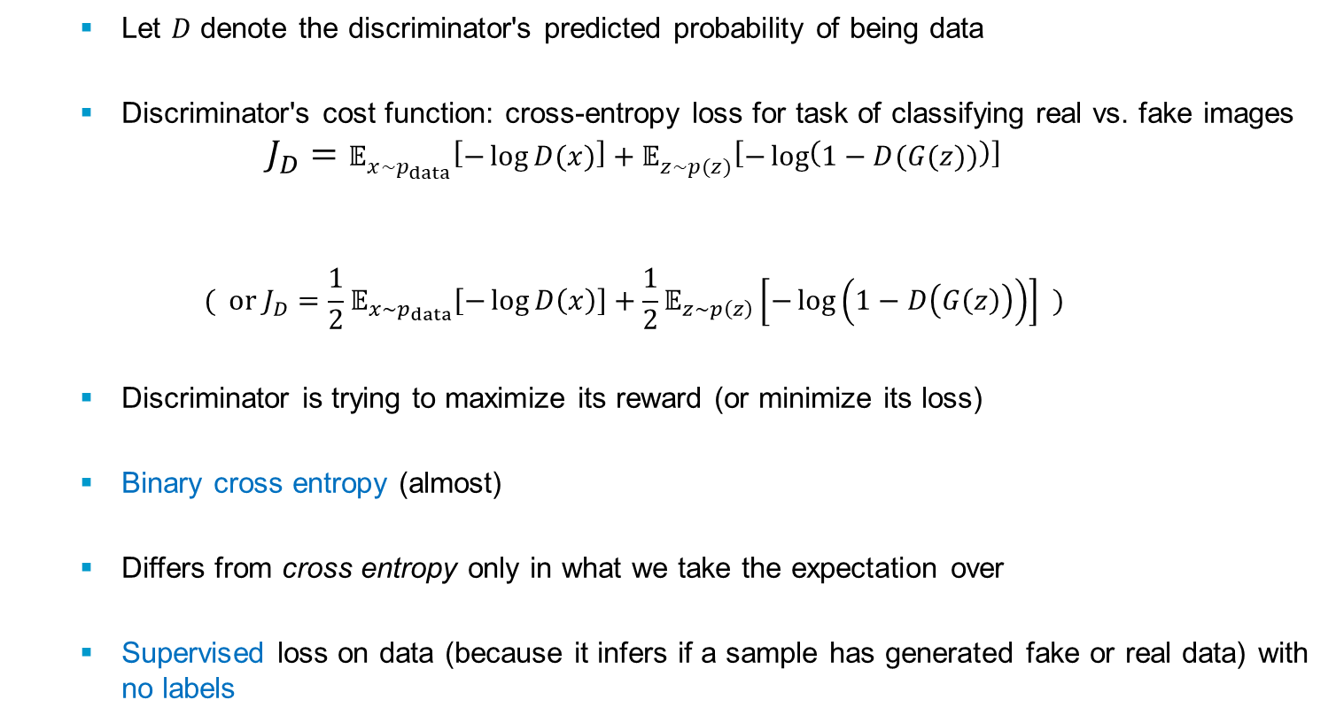
Discriminator Loss Function
Let $D$ denote the discriminator's predicted probability of being data
Discriminator's cost function: cross-entropy loss for task of classifying real vs. fake images
$$J_{D}=𝔼_{x\sim p_{data}}\left[−\log{D(x)}\right]+𝔼_{z\sim p(z)}\left[−\log\left(1−D(G(z))\right)\right]$$
$$( or J_{D}={\frac{1}{2}𝔼}_{x\sim p_{data}}\left[−\log{D\left(x\right)}\right]+\frac{1}{2}𝔼_{z\sim p\left(z\right)}\left[−\log\left(1−D\left(G\left(z\right)\right)\right)\right] )$$
Discriminator is trying to maximize its reward (or minimize its loss)
Binary cross entropy (almost)
Differs from cross entropy only in what we take the expectation over
Supervised loss on data (because it infers if a sample has generated fake or real data) with no labels
Real data (positive classification)
Fake data (negative classification)
Notes:
Ajouter une photo d’un vieux telegraphe, puis un mobile satellitte ancienne generation…can someone find an even older wireless communication system (smoke)

Slide 23
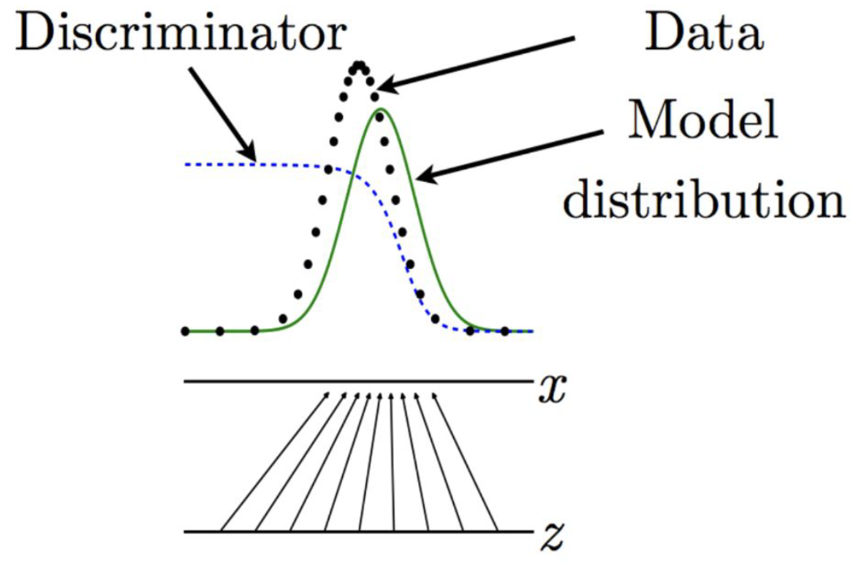
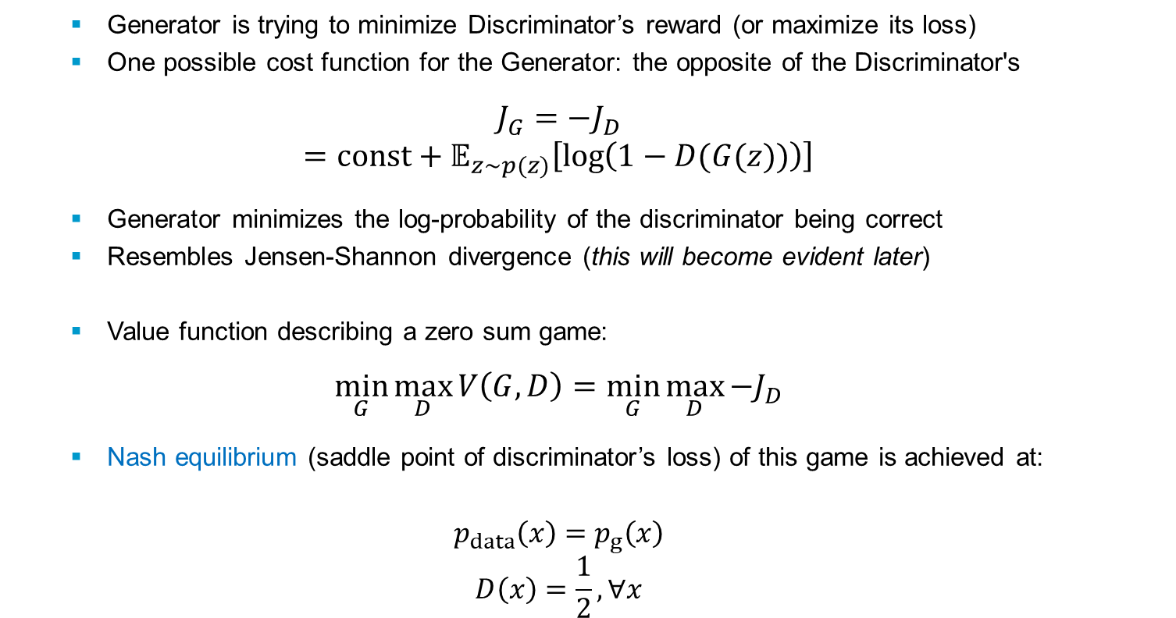
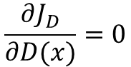
Generator Loss Function
Generator is trying to minimize Discriminator’s reward (or maximize its loss)
One possible cost function for the Generator: the opposite of the Discriminator's
$$J_{G}=−J_{D}$$
$$=const+𝔼_{z\sim p(z)}\left[\log\left(1−D(G(z))\right)\right]$$
Generator minimizes the log-probability of the discriminator being correct
Resembles Jensen-Shannon divergence (this will become evident later)
Value function describing a zero sum game:
$$\min_{G}{\max_{D}{V\left(G,D\right)}}=\min_{G}{\max_{D}{−J_{D}}}$$
Nash equilibrium (saddle point of discriminator’s loss) of this game is achieved at:
$$p_{data}\left(x\right)=p_{g}\left(x\right)$$
$$D\left(x\right)=\frac{1}{2}, ∀x$$
$$\frac{∂J_{D}}{∂D(x)}=0$$
Notes:
Ajouter une photo d’un vieux telegraphe, puis un mobile satellitte ancienne generation…can someone find an even older wireless communication system (smoke)

Slide 24
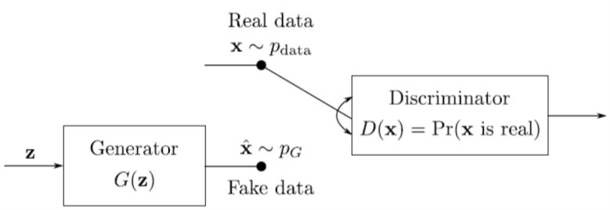
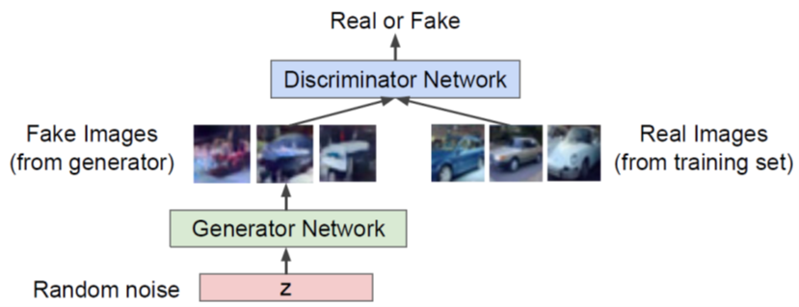
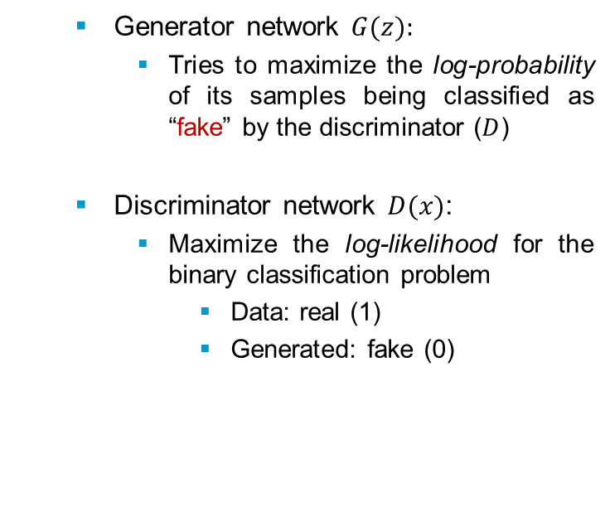
GANs – Recap
Generator network $G(z):$
Tries to maximize the log-probability of its samples being classified as “fake” by the discriminator ($D$)
Discriminator network $D(x)$:
Maximize the log-likelihood for the binary classification problem
Data: real (1)
Generated: fake (0)
Notes:
Ajouter une photo d’un vieux telegraphe, puis un mobile satellitte ancienne generation…can someone find an even older wireless communication system (smoke)

Slide 25


Adversarial Nets Framework
I. Goodfellow NIPS2016
Notes:
Ajouter une photo d’un vieux telegraphe, puis un mobile satellitte ancienne generation…can someone find an even older wireless communication system (smoke)

Slide 26




GANs – Parameterized Optimization Model
Generator/Discriminator are DNNs trained jointly
Minimax objective function:
Discriminator outputs likelihood in (0,1) of real image
Discriminator output for real data $x$
Discriminator output for generated fake data $G(z)$
Generator ($θg$) wants to minimize objective such that $D(G(z))$is close to 1 (discriminator is fooled into thinking generated $G(z)$ is real)
$G=G_{θ_{g}}:ℝ^{N}↦ℝ^{n}$ is a neural network
${\hat{x}=G}_{θ_{g}}\left(z\right)\sim p_{g}$, for some prior distribution on the noise 𝒛∼𝑝_{𝒛}
Typical choice $p_{z}\left(z\right)=𝒩(z,σ^{2}I)$
Discriminator ($θd$) wants to maximize objective such that $D(x)$ is close to 1 (real) and $D(G(z))$is close to 0 (fake)
$D=D_{θ_{d}}:ℝ^{n}↦[0,1]$ is another neural network
$D_{θ_{d}}$ is a binary classifier with sigmoid output activation
$D_{θ_{d}}=ℙ(x is generated by p_{data})$
Notes:
Ajouter une photo d’un vieux telegraphe, puis un mobile satellitte ancienne generation…can someone find an even older wireless communication system (smoke)

Slide 27

Vanilla GAN Training Algorithm
Optional…
Some find k = 1
more stable,
others use k > 1,
no best rule.
Recent work (e.g.
Wasserstein GAN)
alleviates this
problem, better
stability!
I. Goodfellow et al. 2014
Notes:
Ajouter une photo d’un vieux telegraphe, puis un mobile satellitte ancienne generation…can someone find an even older wireless communication system (smoke)

Slide 28



GANs: Bayes-Optimal Discriminator (fixed G)
What’s the optimal discriminator $D(x)$ for any generated $p_{g}\left(x\right)$ and true $p_{data}\left(x\right)$ distributions?
$$\frac{∂V(G,D)}{∂D(x)}=0$$
We assume that $p_{data}\left(x\right)$ and $p_{g}\left(x\right)$are non-zero everywhere
Notes:
Ajouter une photo d’un vieux telegraphe, puis un mobile satellitte ancienne generation…can someone find an even older wireless communication system (smoke)

Slide 29









Training Process and Optimal Discriminator
Iterate the two steps until convergence (which may not happen!)
Updating the Discriminator should make it better at discriminating between real images and generated ones (Discriminator improves)
Updating the Generator makes it better at fooling the current Discriminator (Generator improves)
Eventually (hope) the Generator gets so good that it is impossible for the Discriminator to tell the difference between real and generated images (discriminator accuracy = 0.5)
Best strategy for the Discriminator: learn the ratio of the probabilities of 𝑥 under the data distribution and the generator distribution: $D^{∗}\left(x\right)=\frac{p_{data}\left(x\right)}{p_{data}\left(x\right)+p_{g}\left(x\right)}=p_{data}\left(data|x\right)$
$$p_{data}\left(x\right)$$
$$p_{data}\left(x\right)=p_{g}\left(x\right)$$
$$D\left(x\right)$$
$$D^{∗}\left(x\right)$$
$$D\left(x\right)$$
$$p_{g}\left(x\right)$$
$$D^{∗}\left(x\right)$$
Notes:
Ajouter une photo d’un vieux telegraphe, puis un mobile satellitte ancienne generation…can someone find an even older wireless communication system (smoke)

Slide 30


GANs: Bayes-Optimal Discriminator
Estimating this ratio using supervised learning is the key approximation mechanism used by GANs
$$D^{∗}\left(x\right)=\frac{p_{data}\left(x\right)}{p_{data}\left(x\right)+p_{g}\left(x\right)}$$
Mapping from $z$ to $x$ (black arrows) is non-uniform so that $p_{model}(x)$(green curve) is greater in places where $z$ values are brought together more densely.
Discriminator (dashed blue line) estimates the ratio between the data density (black dots) and the sum of the data and model densities.
Wherever the output of the Discriminator is large, the model density is too low
Wherever the output of the Discriminator is small, the model density is too high.
Generator can learn to produce a better model density by following the Discriminator uphill; each$G(z)$ value should move slightly in the direction that increases $D(G(z)).$
Notes:
Ajouter une photo d’un vieux telegraphe, puis un mobile satellitte ancienne generation…can someone find an even older wireless communication system (smoke)

Slide 31



Optimal Generator (under fixed optimal D*)
Generator Objective under Bayes-Optimal Discriminator $D^{∗}\left(x\right)$
Global optimum for this game is achieved if and only if $p_{data}\left(x\right)=p_{g}\left(x\right)$
We are, in theory, minimizing the Jensen-Shannon divergence between the Generator distribution and the true data distribution!
Notes:
Ajouter une photo d’un vieux telegraphe, puis un mobile satellitte ancienne generation…can someone find an even older wireless communication system (smoke)

Slide 32

Gaps between Theory and Practice
For models that have enough capacity if we use ${J_{G}=−J}_{D}$, and if 𝐷 is set to its global optimum given 𝐺 at every iteration and 𝐺 improves the criterion at every iteration, then alternating optimization will get us to the global optimum
In practice:
𝐷,𝐺 may not have enough capacity
We do not get to find the global optimum for 𝐷 at each iteration
Theory assumes we can reach a global optimum
we have functions which are non convex in the parameters
Theory assumes that $p_{data}\left(x\right)$ and $p_{g}\left(x\right)$ are non zero everywhere.
This may not hold especially if we have data lying on a manifold.
Even when it holds the ratio can be numerically unstable
Theory assumes that the optimal discriminator is unique.
In practice other discriminators can do nearly as good a job: i.e. the discriminator can overfit the data
Notes:
Ajouter une photo d’un vieux telegraphe, puis un mobile satellitte ancienne generation…can someone find an even older wireless communication system (smoke)

Slide 33



Vanishing Gradient Problem with Generator
$$\min_{G}{\max_{D}{V\left(G,D\right)}}$$
$$\underset{ G}{=min}{\max_{D}{𝔼_{x\sim p_{data}}\left[\log{D(x)}\right]+𝔼_{z\sim p(z)}\left[\log\left(1−D(G(z))\right)\right]}}$$
$$∇_{θ_{G}}V\left(G,D\right)=∇𝔼_{z\sim p(z)}\left[\log\left(1−D(G(z))\right)\right]$$
If $D$ is confident, gradient goes to 0, i.e., $D(G(z))→0$
There is no gradient signal to help the generator improve
Solution (heuristic)
$J_{G}=−𝔼_{z\sim p(z)}\left[\log\left(D(G(z))\right)\right]$
Generator maximizes the log probability of the
discriminator’s mistake
$D\left(G\left(z\right)\right)→0⇒−𝔼_{z\sim p(z)}\left[\log\left(D(G(z))\right)\right]→∞$
Gradient gets bigger when $D$gets better
Shown to give the same stationary point
(under some assumptions) as ${J_{G}=−J}_{D}$
Notes:
Ajouter une photo d’un vieux telegraphe, puis un mobile satellitte ancienne generation…can someone find an even older wireless communication system (smoke)

Slide 34




Comparing Various Generator Loss Functions
Generators cost is a function $D(G(z))$
Minimax: $J_{G}=−J_{D}$
Non-saturating heuristic: $J_{G}=−𝔼_{z\sim p(z)}\left[\log\left(D(G(z))\right)\right]$
Maximum Likelihood cost: $J_{G}=−𝔼_{z\sim p\left(z\right)}exp⁡(σ^{−1}(D(G(z)))$
ML Estimation: can be shown equivalent to minimizing KL divergence between $p_{data}\left(x\right)$ and $p_{g}\left(x\right)$ (under certain assumptions)
able to learn even if the
gradient signal is low
Other options in the loss
Energy-based GAN
$f$-GAN
Wasserstein GAN
Notes:
Ajouter une photo d’un vieux telegraphe, puis un mobile satellitte ancienne generation…can someone find an even older wireless communication system (smoke)

Slide 35

Training GANs: Two Player Game
I. Goodfellow et al., “Generative Adversarial Nets”, NIPS 2014
Notes:
Ajouter une photo d’un vieux telegraphe, puis un mobile satellitte ancienne generation…can someone find an even older wireless communication system (smoke)

Slide 36

Training GANs: Two Player Game (Cont’d)
Equilibrium is a saddle point of the discriminator loss
Resembles Jensen-Shannon divergence
Generator minimizes the log-probability of the discriminator being correct
I. Goodfellow et al., “Generative Adversarial Nets”, NIPS 2014
Notes:
Ajouter une photo d’un vieux telegraphe, puis un mobile satellitte ancienne generation…can someone find an even older wireless communication system (smoke)

Slide 37


GAN samples look sharp
Real samples
Fake samples
Berthelot et al.: BEGAN: Boundary Equilibrium GANs, arxiv.org, 2017
Notes:
Ajouter une photo d’un vieux telegraphe, puis un mobile satellitte ancienne generation…can someone find an even older wireless communication system (smoke)

Slide 38
GAN samples look sharp
Real samples
Boundary Equilibrium GAN (BEGAN)
Fake samples
Energy based GAN
Berthelot et al.: BEGAN: Boundary Equilibrium GANs, arxiv.org, 2017
Notes:
Ajouter une photo d’un vieux telegraphe, puis un mobile satellitte ancienne generation…can someone find an even older wireless communication system (smoke)

Slide 39


Why GANs work better than VAEs?
GANs can be trained with ML and still generate sharp samples
KL divergence not symmetric
minimizing
$D_{KL} (p_{data} ||{ p}_{model})$
is different
from minimizing
$D_{KL} (p_{model} ||{ p}_{data})$
We use a mixture of two Gaussians for $p$ (data distribution), and a single Gaussian for $q$ (model family).
ML: model chooses to average out the two modes (places high probability on both of them)
Reverse KL: model chooses to capture only one of the two modes (both are local minima)
$D_{KL} (p_{data} ||{ p}_{model})$: place high probability everywhere that the data occurs
$D_{KL} (p_{model} ||{ p}_{data})$: prefers to place low probability wherever the data does not occur
GANs often choose to generate from very few modes - Reverse KL prefers to generate from as many modes of the data distribution as the model is able to; it does not prefer fewer modes in general.
Notes:
Ajouter une photo d’un vieux telegraphe, puis un mobile satellitte ancienne generation…can someone find an even older wireless communication system (smoke)

Slide 40

KL and JSD
Notes:
Ajouter une photo d’un vieux telegraphe, puis un mobile satellitte ancienne generation…can someone find an even older wireless communication system (smoke)

Slide 41

Training Problem: Non Convergence
Deep Learning models (in general) involve a single player
The player tries to maximize its reward (minimize its loss).
Use SGD (with Backpropagation) to find the optimal parameters.
SGD has convergence guarantees (under certain conditions).
Problem: With non-convexity, we might converge to local optima.
$$\min_{G}{L\left(G\right)}$$
GANs instead involve two (or more) players
Discriminator is trying to maximize its reward.
Generator is trying to minimize Discriminator’s reward.
$\min_{G}{\max_{D}{V\left(G,D\right)}}$
SGD was not designed to find the Nash equilibrium of a game.
Problem: We might not converge to the Nash equilibrium at all.
Notes:
Ajouter une photo d’un vieux telegraphe, puis un mobile satellitte ancienne generation…can someone find an even older wireless communication system (smoke)

Slide 42





An Example of Non Convergence
$$\min_{x}{\max_{y}{V\left(x,y\right)}}$$
with $V\left(x,y\right)=xy$
$D$ & $G$ nullifies each others learning in every iteration
Differential equation’s solution has sinusoidal terms
Even with a small learning rate, it will not converge
I. Goodfellow, NIPS 2016 Tutorial, arxiv.org, 2017
Notes:
Ajouter une photo d’un vieux telegraphe, puis un mobile satellitte ancienne generation…can someone find an even older wireless communication system (smoke)

Slide 43


Training Problem: Mode Collapse (Helvetica)
Generator fails to output diverse samples
Generator produces good samples, but a very few of them.
Thus, Discriminator can’t tag them as fake.
Target
Expected
Output
Notes:
Ajouter une photo d’un vieux telegraphe, puis un mobile satellitte ancienne generation…can someone find an even older wireless communication system (smoke)

Slide 44


Mode Collapse – Some Solutions
Mini-batch GANs - Reward sample complexity
Let $D$ look at the entire batch instead of single examples
Lack of diversity, examples will be marked as fake $⇒$ $G$ forced to produce diverse samples.
Extract features that capture diversity in the mini-batch (e.g., L2 norm of the difference between all pairs from the batch)
Feed those features to the discriminator along with the image
Feature values will differ black and white diverse and non-diverse batches
Thus, $D$ will rely on those features for classification
$⇒$ will force the $G$ to match those feature values with the real data - will generate diverse
Supervision with labels
Label information of the real data might help
Unrolled GANs
WGANs
Notes:
Ajouter une photo d’un vieux telegraphe, puis un mobile satellitte ancienne generation…can someone find an even older wireless communication system (smoke)

Slide 45
Training GANs – In a Nutshell
Why GANs are hard to train?
Generator keeps generating similar images – so nothing to learn
Maintain tradeoff of generating more accurate vs high coverage samples
The two learning tasks need to have balance to achieve stability
If Discriminator is not sufficiently trained – it can worse generator
If Discriminator is over-trained - will produce no gradients
Tricks to Train GAN
One sided label smoothing
Historical generated batches
Feature Matching
Mini-batch Discrimination
Virtual Batch Normalization
Regularizing discriminator gradient in region around real data (DRAGAN)
…
Notes:
Ajouter une photo d’un vieux telegraphe, puis un mobile satellitte ancienne generation…can someone find an even older wireless communication system (smoke)

Slide 46

GANs: Pros and Cons
Pros (Why GANs?)
Sampling (or generation) is straightforward.
Training does not involve ML estimation.
Robust to Overfitting since Generator never sees the training data.
Empirically, GANs are good at capturing the modes of the distribution
Can be trained to draw realistic sharp samples! (best possible)
Cons
Trickier / more unstable to train properly, they do not always converge
Optimization can oscillate between solutions
Generator can collapse
Probability Distribution is Implicit: not straightforward to solve inference queries such as $p\left(x\right), p\left(z | x\right)$
Vanilla GANs are only good for Sampling/Generation.
Training requires finding the Nash equilibrium of a game – a more difficult problem than optimizing an objective function
Notes:
Ajouter une photo d’un vieux telegraphe, puis un mobile satellitte ancienne generation…can someone find an even older wireless communication system (smoke)

Slide 47
GAN Samples
GAN samples
GANs revolutionized generative modeling by producing crisp, high-resolution images.
The catch: we don't know how well they're modeling the distribution.
Can't measure the log-likelihood they assign to held-out data.
Could they be memorizing training examples? (E.g., maybe they sometimes produce photos of real celebrities?)
We have no way to tell if they are dropping important modes from the distribution.
GAN Evaluation
Another issue with GANs is quantitative comparison
There is no explicit likelihood to calculate
Post hoc density estimation can be used, but is inaccurate
Subjective evaluation by humans currently the best method (Fréchet inception distance)
Active area of research – various challenges:
How to evaluate GANs??
Better loss functions, more stable training (Wasserstein GAN, LSGAN, many others)
Finding Nash equilibria in high-dimensional, continuous, nonconvex games
Notes:
Ajouter une photo d’un vieux telegraphe, puis un mobile satellitte ancienne generation…can someone find an even older wireless communication system (smoke)

Slide 48






WGAN
If data lies on a low dimensional manifold of a high dimensional space the model’s manifold and the true data manifold can have a negligible intersection in practice
KL divergence is undefined or infinite
The loss function and gradients may not be continuous and well defined
Wasserstein distance is well defined:
Minimum transportation cost for making one pile of dirt (pdf/pmf ) look like the other
Earth Mover’s Distance (Wasserstein-1 metric):
Considering one distribution$P$as a pile of earth (total amount of earth is 1), and another distribution $Q$ (another pile of earth) as the target
EMD is the average distance the earth mover has to move the earth in an optimal plan.
$$P$$
$$Q$$
$$d$$
$$𝒲\left(P,Q\right)=d$$
Notes:
Ajouter une photo d’un vieux telegraphe, puis un mobile satellitte ancienne generation…can someone find an even older wireless communication system (smoke)

Slide 49





Wasserstein Distance
Discrete case: suppose we have two distributions $P$ and $Q$, each has four piles of dirt and both have ten shovelfuls of dirt in total.
The numbers of shovelfuls in each dirt pile are assigned as follows:
$$P1=3,P2=2,P3=1,P4=4$$
$$Q1=1,Q2=2,Q3=4,Q4=3$$
Label the cost to pay to make $P_{i}$ and $Q_{i}$ match as $δ_{i}$:
$$δ_{i+1}=δ_{i}+P_{i}−Q_{i}$$
So the Wasserstein distance is
Notes:
Ajouter une photo d’un vieux telegraphe, puis un mobile satellitte ancienne generation…can someone find an even older wireless communication system (smoke)

Slide 50



Wasserstein Distance vs. KL vs. JSD
Notes:
Ajouter une photo d’un vieux telegraphe, puis un mobile satellitte ancienne generation…can someone find an even older wireless communication system (smoke)

Slide 51

CycleGAN
Style transfer problem: change the style of an image while preserving the content.
Data: Two unrelated collections of images, one for each style
Notes:
Ajouter une photo d’un vieux telegraphe, puis un mobile satellitte ancienne generation…can someone find an even older wireless communication system (smoke)

Slide 52
CycleGAN
If data was paired (same content in both styles), this would be a supervised learning problem. But this is hard to find.
The CycleGAN architecture learns to do it from unpaired data.
Train two different generator nets to go from style 1 to style 2, and vice versa.
Make sure the generated samples of style 2 are indistinguishable from real images by a discriminator net.
Make sure the generators are cycle-consistent: mapping from style 1 to style 2 and back again should give you almost the original image.
Notes:
Ajouter une photo d’un vieux telegraphe, puis un mobile satellitte ancienne generation…can someone find an even older wireless communication system (smoke)

Slide 53

CycleGAN
Notes:
Ajouter une photo d’un vieux telegraphe, puis un mobile satellitte ancienne generation…can someone find an even older wireless communication system (smoke)

